Slide 1
PEGA
Exposing APIs

Slide 2
Exposing APIs
API stands for Application Program Interface.
In Pega we can expose the APIs by creating connectors and services in Pega.
If we need some data from other application to process a request, then we can use a connector rule.
If some other application depends on Pega data, then we can use service rule to service their request.

Slide 3
Services-REST in Pega:
REST can use JSON,XML or HTML as messaging formats to transfer data.
REST can only URI to expose the service to outside world.
Pega Don’t provide us any wizard to create Service-REST.
We need to follow the below steps for creating the Service-REST :
Step 1 : First we need to create Integration class structure manually.
Step 2 : Create the request and response properties.
Step 3 : Create Service REST rule.
Step 4 : Create a new service activity.

Slide 4
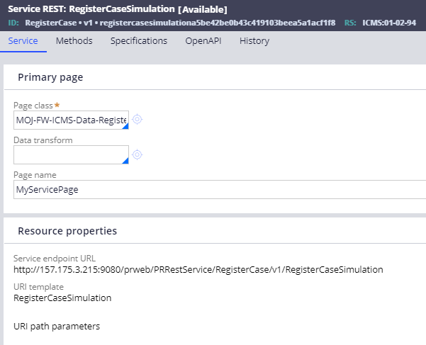
In Appeal application, we have used service-REST rule for creating a work object in pega using POST method:

Slide 5
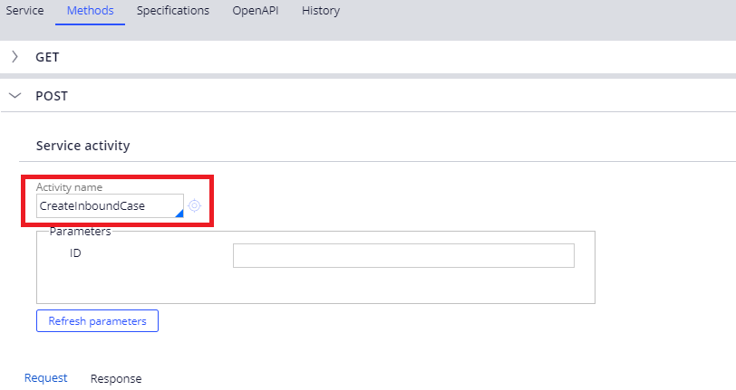
8.4 new features
Under the Methods tab, “CreateInboundCase” activity has been used to create a work object.

Slide 6
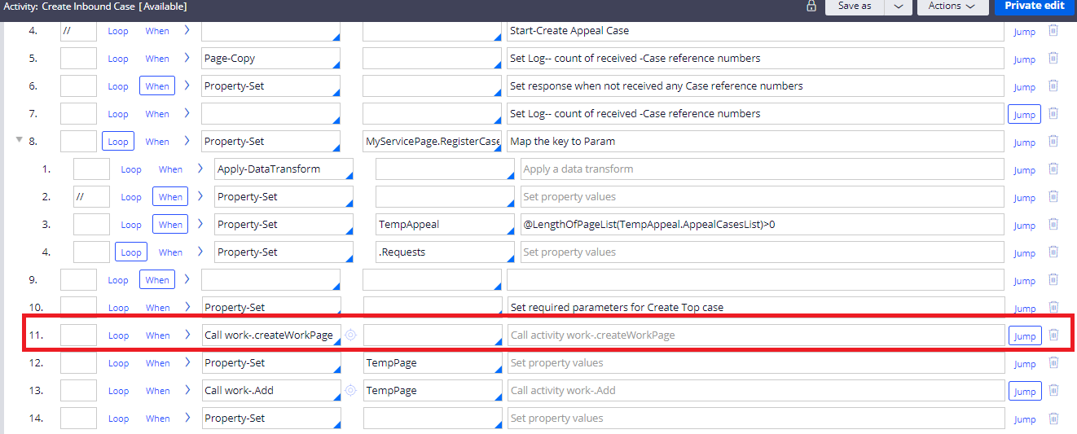
8.4 new features
In the activity, step 11 is used to create the work object. “CreateWorkPage” activity is used to work object in Pega.

Slide 7
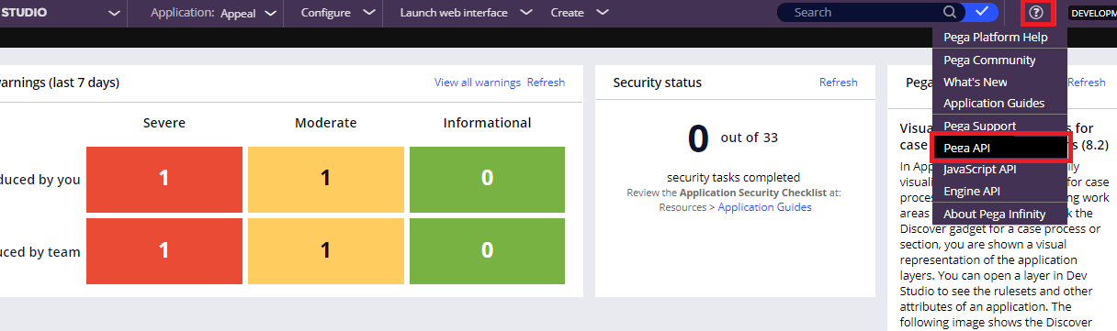
8.4 new features
Pega provides us lots of out of the box DX APIs. From the Resource menu we can select the Pega API.

Slide 8
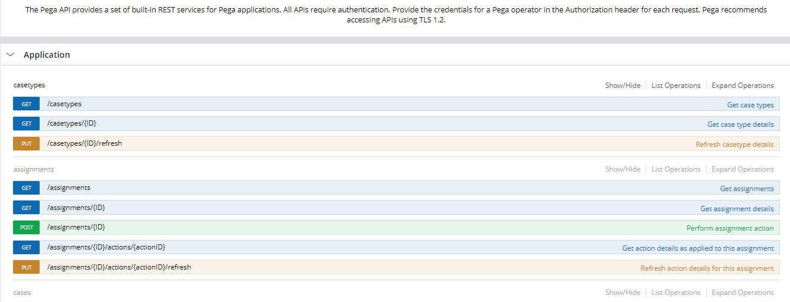
8.4 new features

Slide 9
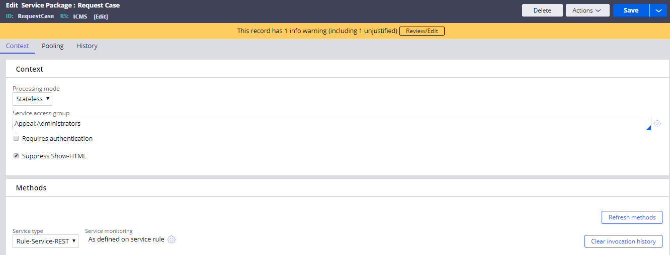
Service Package
Service packages are data instances that support service processing in Pega. They decide the processing mode as either stateful or stateless. It provides security by enabling authentication for the service. The client should send the authorization parameters to get serviced.

Slide 10
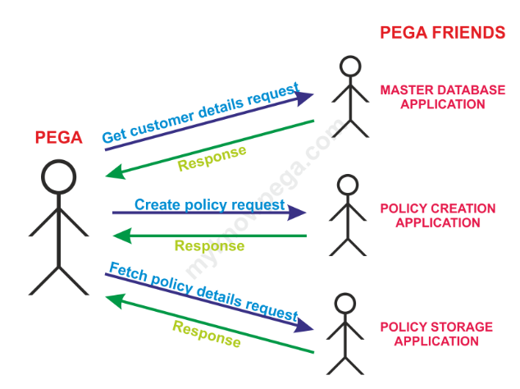
Connect-REST in Pega:
Imagine a call center application. The policy creation process is not handled within Pega. Policy creation is handled within Pega. Policy creation is handled by some legacy java application. Now when customers calls in and requests to create a policy, then Pega can connect with Java application for policy creation.

Slide 11
Connect-REST in Pega:
It comes under Integration-Connectors category.
This rule helps in implementing connectors with other application using REST.
How to we configure Connect-REST :
Before configuring a Connect REST rule, there are some prerequisites to collect from the service provider:
The Service URL.
Request and Response parameters.
HTTP method they host the service.
Authentication, if any.

Slide 12
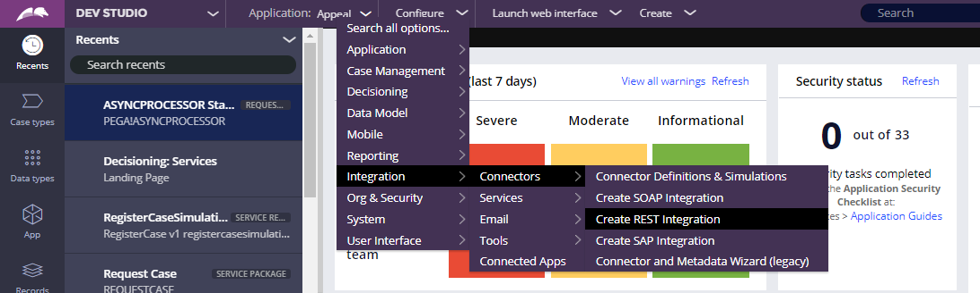
Connect-REST in Pega:
Pega Provides a wizard to create REST Integration.
Configure → Integration → Connectors → Create REST Integration

Slide 13
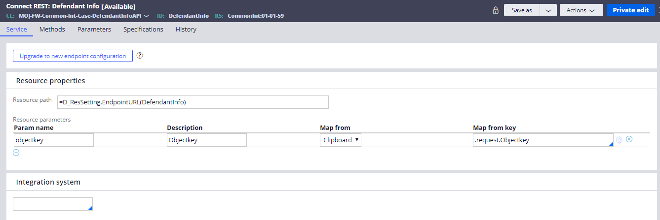
Connect-REST in Pega:
There are many connect-REST get called in Appeal application.
One of the connect-REST is “DefendantInfo” which is used to get the defendant information when passing the “objectkey” as a Request parameter.

Slide 14
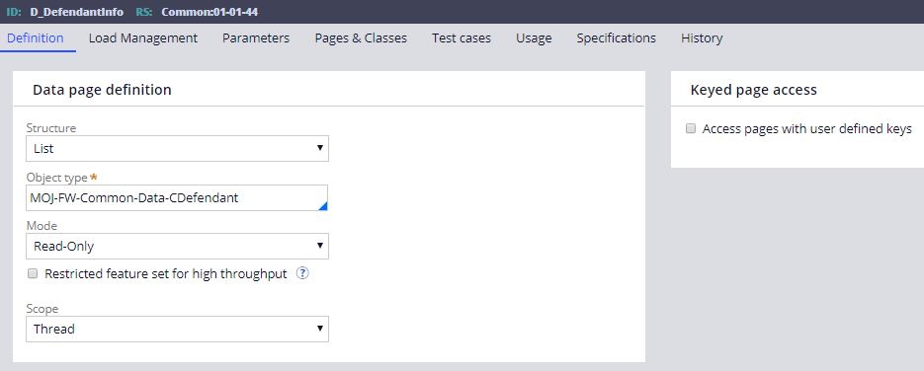
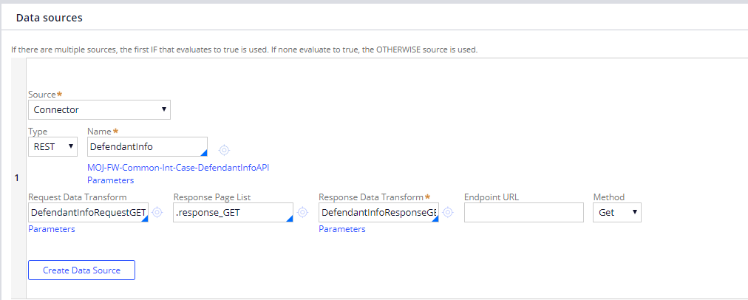
Connect-REST in Pega:
Connect-REST wizard creates a data page when we configure the REST service.
We can use that Data Page any where we needed in the application.
One of the connect-REST is “DefendantInfo” which is used to get the defendant information when passing the “objectkey” as a Request parameter.

Slide 15
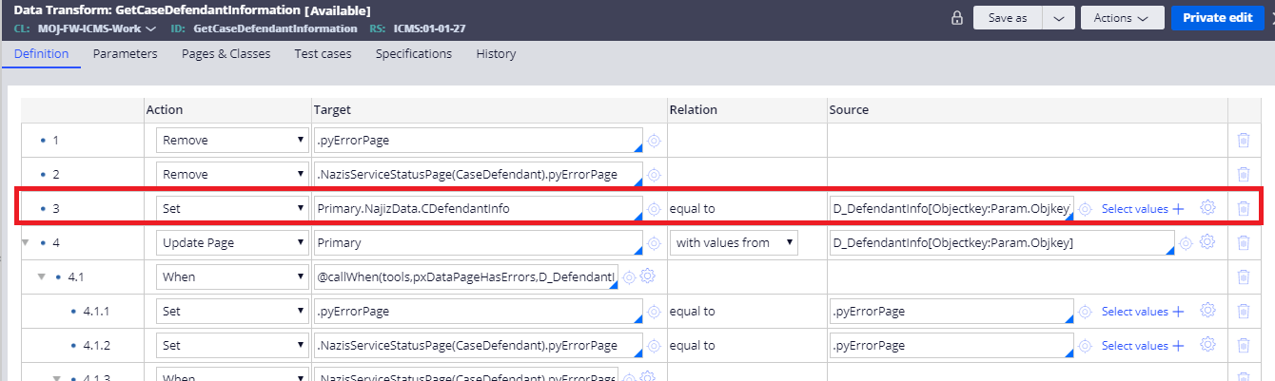
Connect-REST in Pega:
We can use the Data Page in section directly to display the Defendant’s details or can be called from the Data Transform. Data Pages can be called from other rules as well.
In Appeal Application, “GetCaseDefendantInformation” is one of the data transform where we are referring D_DefendantInfo data page.
Parameterised data pages can be referred as:
Primary.NajizData.CDefendantInfo = D_DefendantInfo[Objectkey:Param.Objkey].pxResults
In the above expression “Objectkey” is the request parameter of “D_DefendantInfo”.

